Slide 1
Eyewitness Testimony
HUL261-Tutorial 5

Slide 2
Try and draw the picture of a 10 rupee note

Slide 3
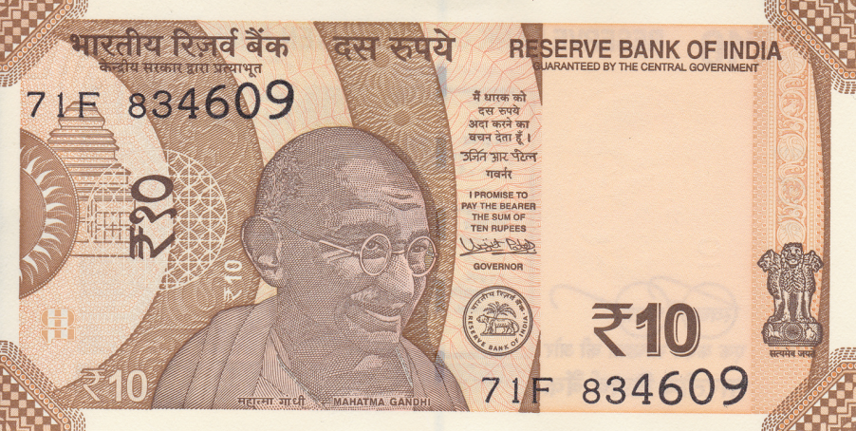
How well did you do?

Slide 4
https://www.youtube.com/watch?v=v_QbTX2qS10&t=3s
https://www.youtube.com/watch?v=VZhcp6dOKds&t=4s
Eyewitness Testimony
Eyewitness testimony is a legal term. It refers to an account given by people of an event they have witnessed.

Slide 5
Relevance in Psychological research?
Most persuasive + Dubious accuracy =
Wrongful convictions
More than 356 people have been exonerated by DNA testing who were wrongly convicted in USA, out of which more than 72% were due to eyewitness misidentification (The innocence project, 2018)

Slide 6
Discussion
What do you think are the factors that affect the accuracy of the eyewitness testimony?
What do you think can be done in order to increase the accuracy of eyewitness testimonies?

Slide 7
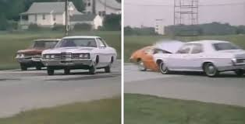
Car Crash Study
https://www.youtube.com/watch?v=RerSlmk_MlY

Slide 8
Loftus & Palmer (1974)
Aim: To investigate the effect of language used in eyewitness testimony on accuracy of recall.
Procedure:
Participants- 45 students / 5 Groups
Films of different traffic accidents were shown.
Eyewitness testimony Question:
About how fast were the cars going when they hit each other ? (Control group)
For other four groups, the question was framed using the verbs- smashed, collided, bumped or contacted (instead of hit).
Which verb do you think elicited the highest estimated speed?
Why?
Notes:
May be we can add a matrix or figure over here

Slide 9
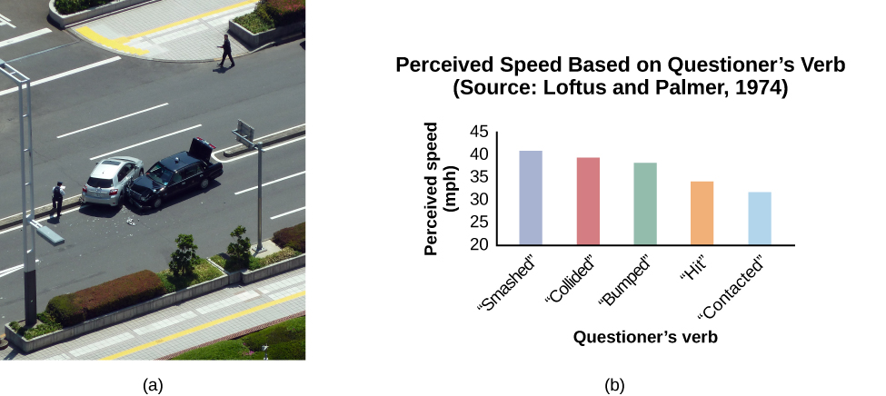
Results

Slide 10
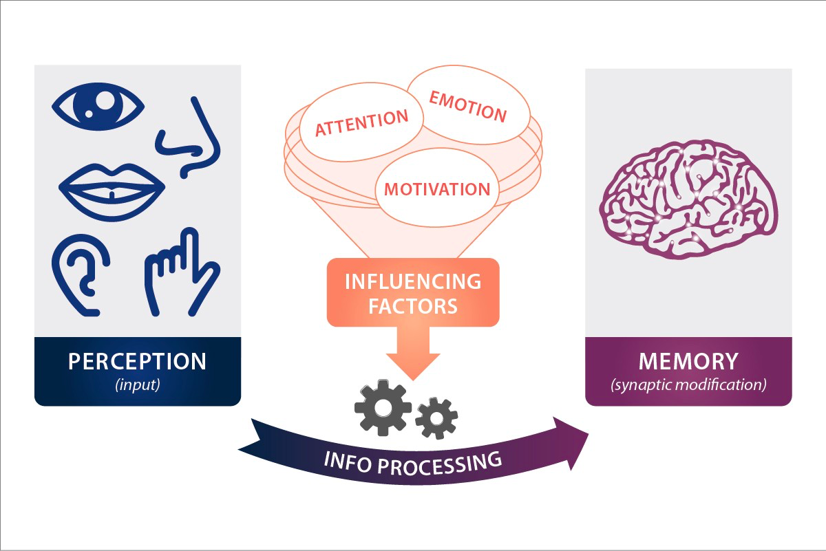
Key psychological processes involved
Attention
Perception (Constructed?)
Memory
Notes:
We can ask them to recall an incident
How are they able to recall a particular incidnet
Based on their ability what are the processes involved
Is perception constructed?
Memories are constructive and are distrupted throgh strog emotove
M

Slide 11
Factors affecting Eyewitness testimony
Conditions under which the crime occurred
Post event discussion and Misinformation effect
Age
Stress and anxiety experienced by the witness
Leading Questions
Notes:
Children and elderly are more proned to false eyewitness testimony
The more stressful situation is, the

Slide 12

Watch on your own: https://www.youtube.com/watch?v=PB2OegI6wvI

